Slide 1
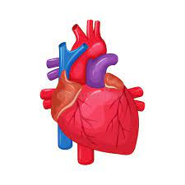
Heart Disease Diagnosis
Team Members:
Tejaswini Kandyala
Manognya Raygir
Nikhil Katakam
Drona

Slide 2

Introduction
The project was conducted, focusing on applying advanced machine learning techniques to predict heart disease in patients based on various medical features. The objective was to develop a reliable classification algorithm that can aid in the early diagnosis of heart-related issues.

Slide 3
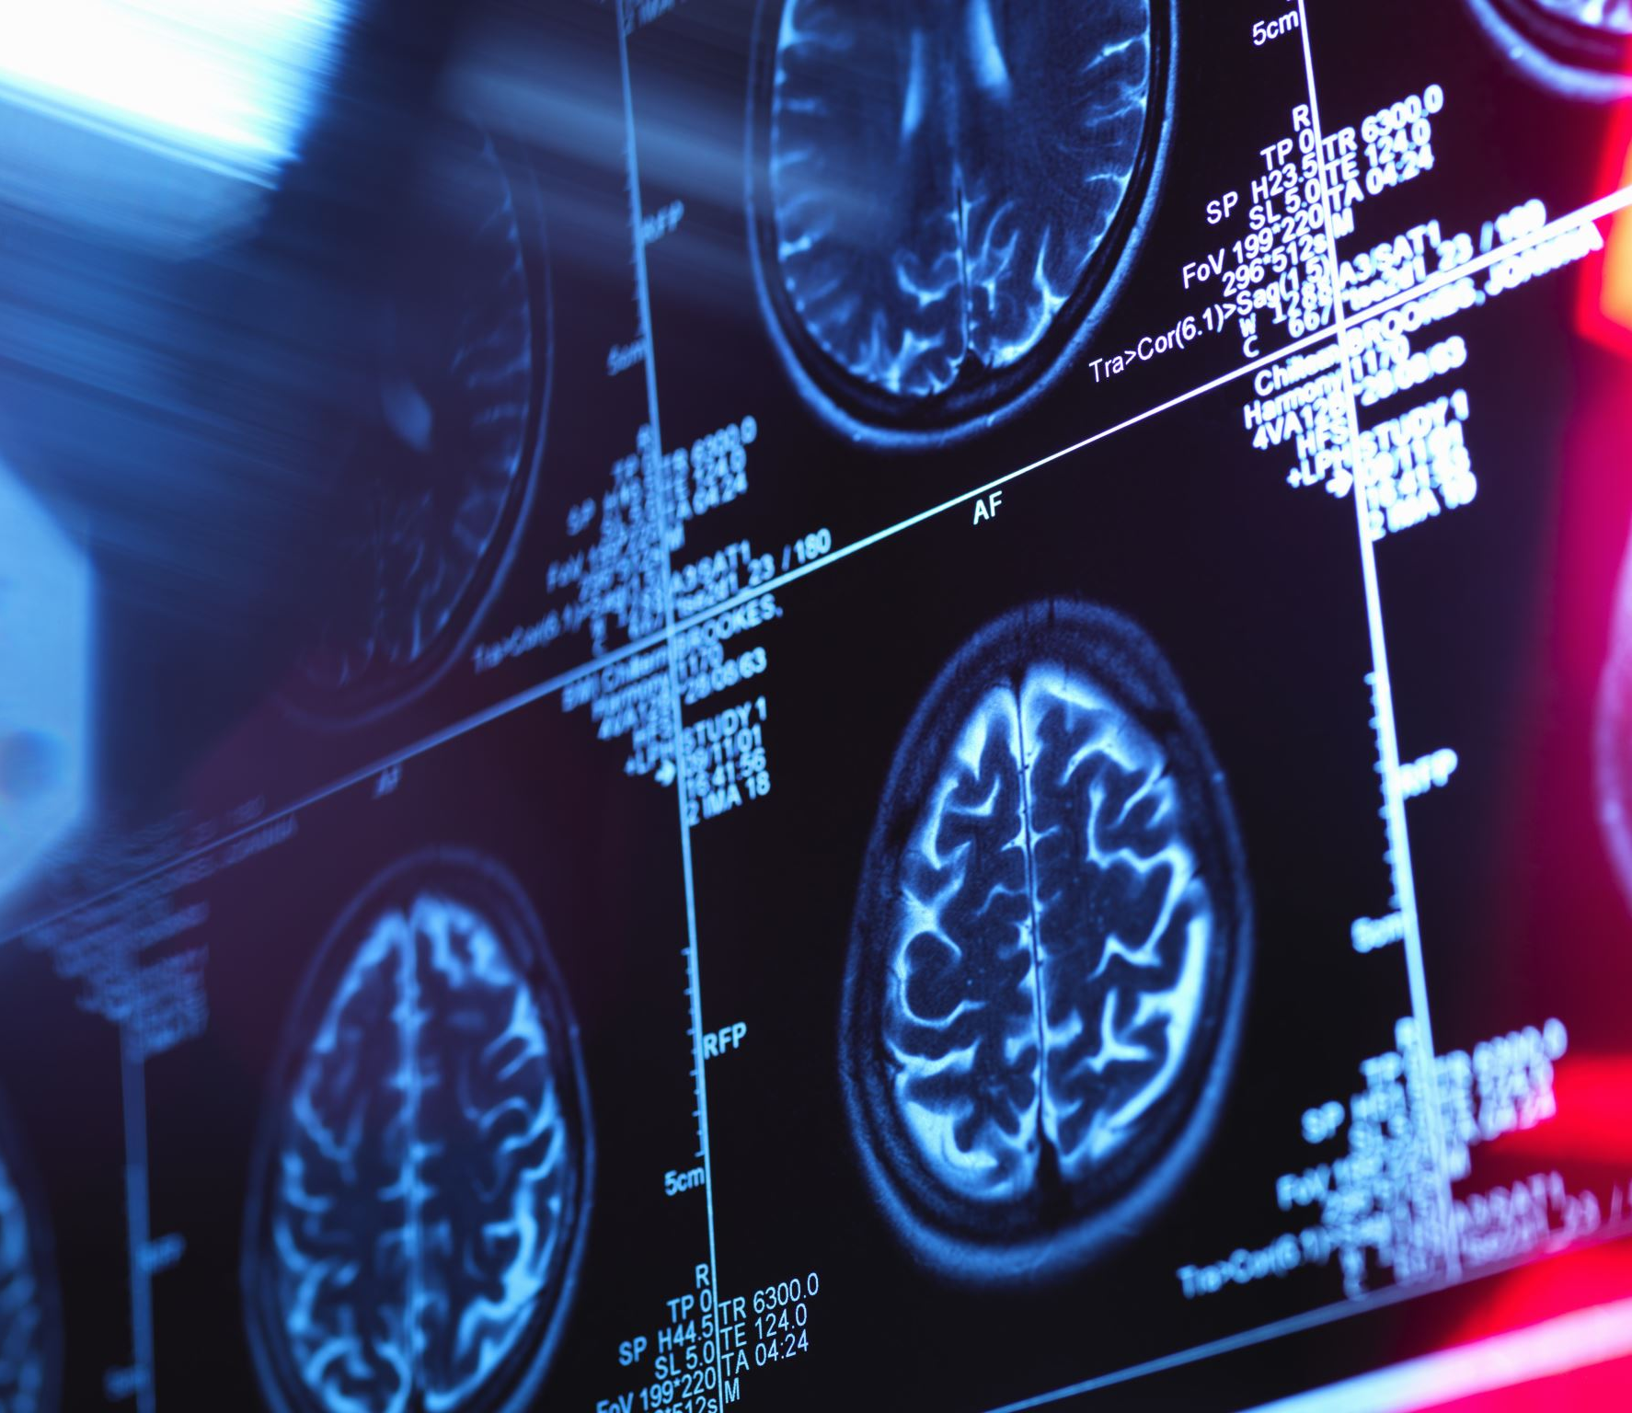
Goals:
Predict whether a patient should be diagnosed with heart disease. This is a binary outcome. Positive(+)=1,patient diagnosed with heart disease Negative (-) = 0, patient not diagnosed with heart disease
Experiment with various Classification Models & see which yields greatest accuracy.
Examine trends & correlations within our data
Determine which features are most important to Positive/Negative Heart Disease diagnosis

Slide 4

INPUT:
The dataset consists of 14 attributes and 1026 instances. There are 8 categorical attributes and 6 numeric attributes.
Patients from age 29 to 79 have been selected in this dataset. Male patients are denoted by a gender value 1 and female patients are denoted by gender value 0.
Attributes such as Age-Age of the person in years
Sex-Gender of the person[1:male,0:female]
Cp-Chest pain type [1-Typical Type 1 Angina
2- Atypical type Angina
3-Non-Angina pain
4-Asymptomatic]
Trestbps-Resting Blood Pressure in mm Hg 94 to 200,
Chol- Serum Cholestrol in mg/dl 126 to 564,
Fbs-Fasting Blood Sugar in mg/dl 0,1

Slide 5
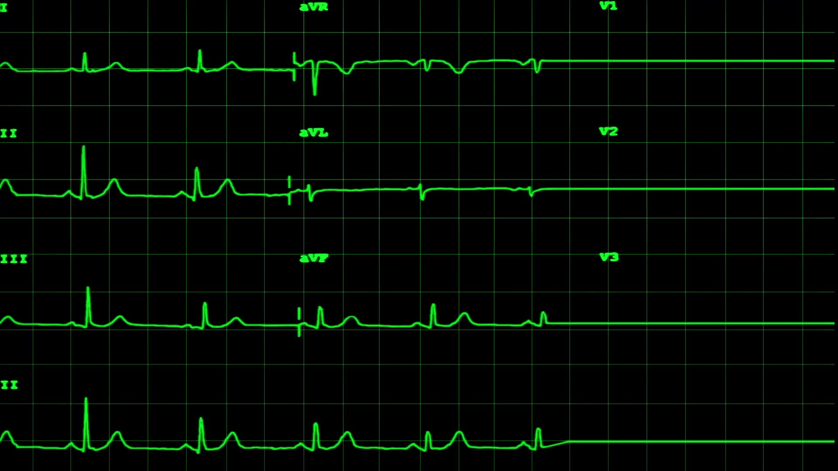
restecg-Resting Electrocardiographic Results 0,1,2
Thalach-Maximum Heart Rate Achieved 71 to 202,
Exang-Exexrcise Induced angina 0,1
Oldpeak- ST depression induced by exercise relative to rest 1 to 3
Slope- Slope of the peak exercise ST segment 1,2,3
Ca- Number of major vessels colored by fluoroscopy 0 to 3
Thal- 3- normal, 6-fixed defect,7-Reversible defect
Target- 0 or 1.

Slide 6
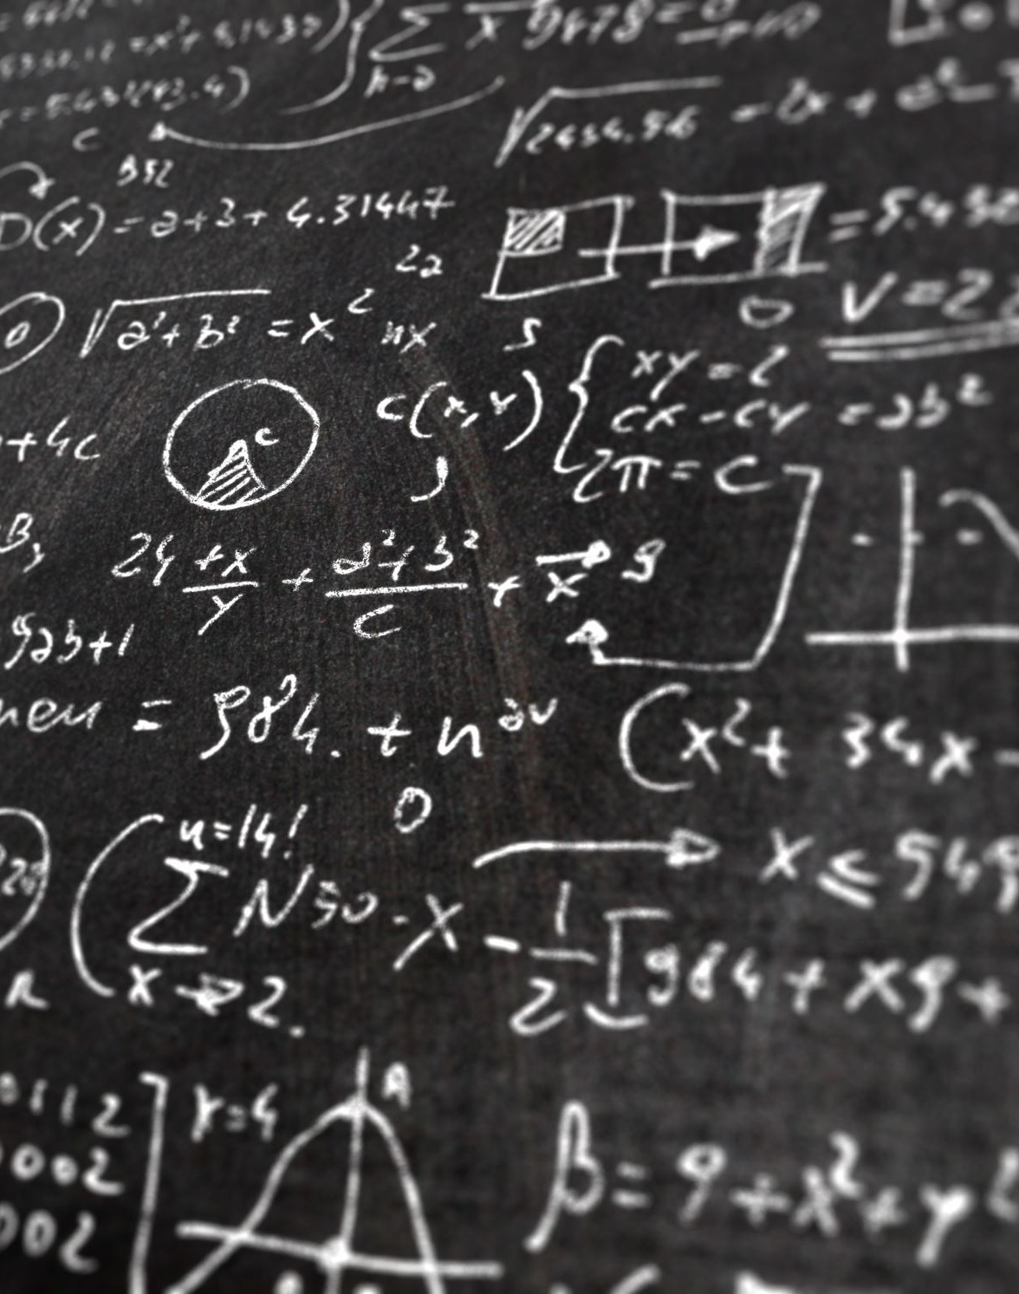
Algorithms Used:
KNN:
Nearest neighbor (KNN) is very simple, most popular, highly efficient and effective algorithm for pattern recognition.
KNN makes predictions by averaging the similarity between an input observation and the data already present.
KNN is preferred when all the features are continuous. KNN is also called as case-based reasoning and has been used in many applications like pattern recognition, statistical estimation.
SVM:
A support vector machine is a type of model used to analyze data and discover patters in classification and regression analysis. Support vector machine (SVM) is used when your data has exactly two classes. An SVM classifies data by finding the best hyper plane that separates all data points of one class from those of the other class. The larger margin between the two classes, the better the model is.

Slide 7
Decision tree algorithm is a predictive modeling technique that maps features to target labels via a tree-like structure of decisions. It recursively splits data based on feature thresholds to create branches, ultimately leading to leaf nodes representing predictions. In Python, libraries like scikit-learn offer implementations. Applied to heart disease prediction, it utilizes patient data like age, blood pressure, and cholesterol levels to classify individuals as having or not having heart disease.
Logistic regression is a statistical method used for binary classification tasks. It models the probability of a binary outcome based on one or more predictor variables. In heart disease prediction, features like age, cholesterol levels, and blood pressure are used to predict the likelihood of heart disease. Python libraries like scikit-learn provide efficient implementations for logistic regression modeling.

Slide 8
Accuracy of KNN is 0.864382257757472
Accuracy of Decision Tree is 0.9853658536585366
Accuracy of SVM is 0.8506493506493507
Accuracy of Logistic Regression is 0.8669
Hence, we observe that applying Decision tree gives more accuracy in determining a person with heart disease.

Slide 9

METHODOLOGY
The methodology is a process which includes steps that transform given data into recognized data patterns for the knowledge of the users.
This model uses 13 medical parameters such as chest pain, fasting sugar, blood pressure, cholesterol, age, sex etc. for prediction .
Collect the data
Extract the significant variables
Data pre-processing
Splitting data
Training data
Testing data

Slide 10
Future Work
The utilization of KNN algorithm and SVM in heart disease prediction offers significant potential for improving accuracy. By implementing strategies such as addressing data imbalance, we can enhance the reliability of this algorithm in healthcare. Moving forward, further research should focus on exploring additional techniques and integrating advanced machine learning approaches to enhance the prediction accuracy and preventive measures for heart disease.

Slide 11

Conclusion:
The project successfully implemented machine learning algorithms for heart disease prediction, achieving notable accuracy rates. By identifying significant features, the model provides valuable insights for early diagnosis and preventive care.

Slide 12

REFERENCES
* Yanwei Xing, Jie Wang and Zhihong Zhao Yonghong Gao 2007 “Combination data mining methods with new medical data to predicting outcome of Coronary Heart Disease” Convergence Information Technology, 2007. International Conference November 2007, pp 868-872.
*Jianxin Chen, Guangcheng Xi, Yanwei Xing, Jing Chen, and Jie Wang 2007 “Predicting Syndrome by NEI
Specifications: A Comparison of Five Data Mining Algorithms in Coronary Heart Disease” Life System Modeling and Simulation Lecture Notes in Computer Science, pp 129-135.
* Seema K,Bomare DS,Vaishnavi N. Heart disease prediction using KNN based handwritten text. AISC 2016; 49-56.
* Diagnosis and prediction of Heart Disease and Blood Pressure along with other attributes using the aid of neural networks- R. Subramanian
* Jabbar MA,Deekshatulu BL,Priti C.Heart disease classification using nearest neighbor classifier with feature subset selection. Annals Computer Science 2013.

Slide 13
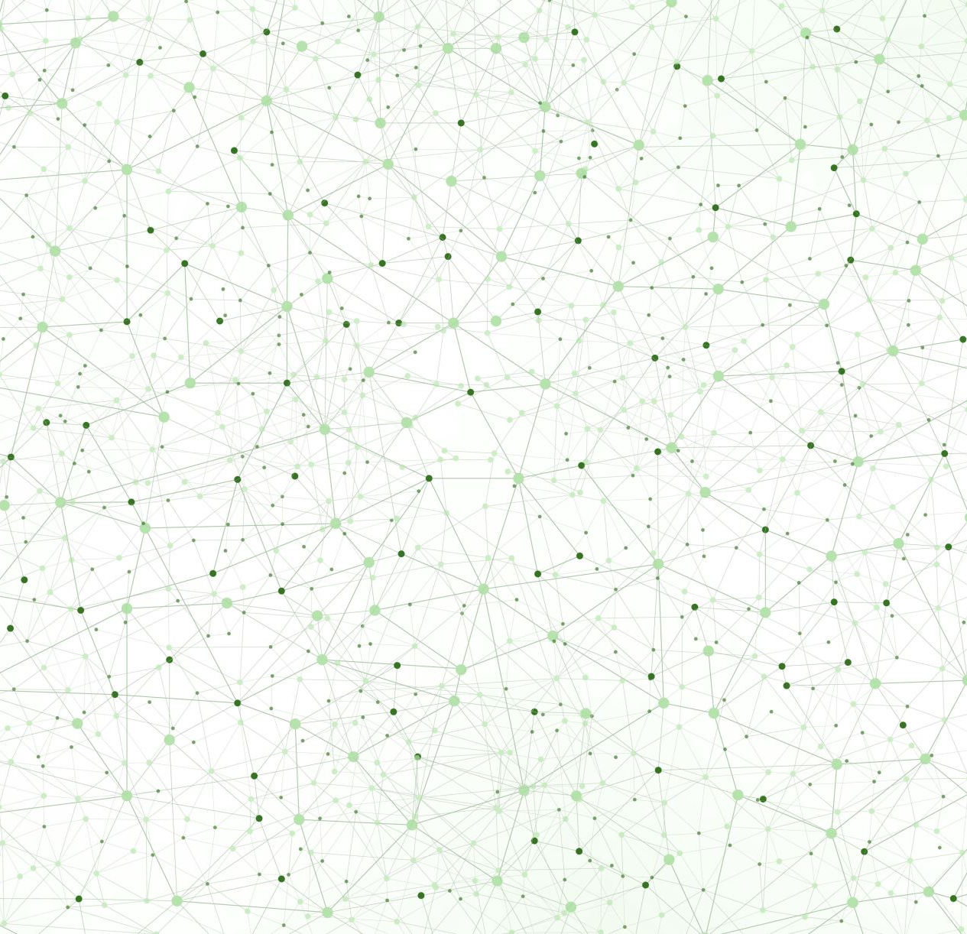
Thank you

